Slide 1
NORTHERN UNIVERSITY BANGLADESH
Presentation on: TO-DO List with Expanse Tracker
PRESENTED BY,
Md. Habibul Azad (1493)
Nuzhat E Rahman(1723)
Tazbih Alam(1728)
Ovijit Ray Ovi(1737)
Humaira Toya(1744)
PRESENTED TO,
Tasfia Tabassum Faija
Lecturer
Department of CSE
Northern University Bangladesh

Slide 2

To-Do List with Expense Tracker: A SQL Schema Deep Dive
Welcome to this presentation on building a robust To-Do List and Expense Tracker system using SQL. We'll explore the database schema, data management, and practical functions to empower users in managing their finances and tasks.

Slide 3
Agenda
What We'll Cover Today
1
Introduction & Overview
Setting the stage for our To-Do List & Expense Tracker.
2
Database Schema Design
Understanding the foundational tables and their relationships.
3
Data Population & Initial Setup
Bringing our database to life with sample records.
4
Practical Stored Procedures & Functions
Streamlining common operations for efficiency.
5
Key Takeaways & Next Steps
Summarising our journey and outlining future possibilities.

Slide 4
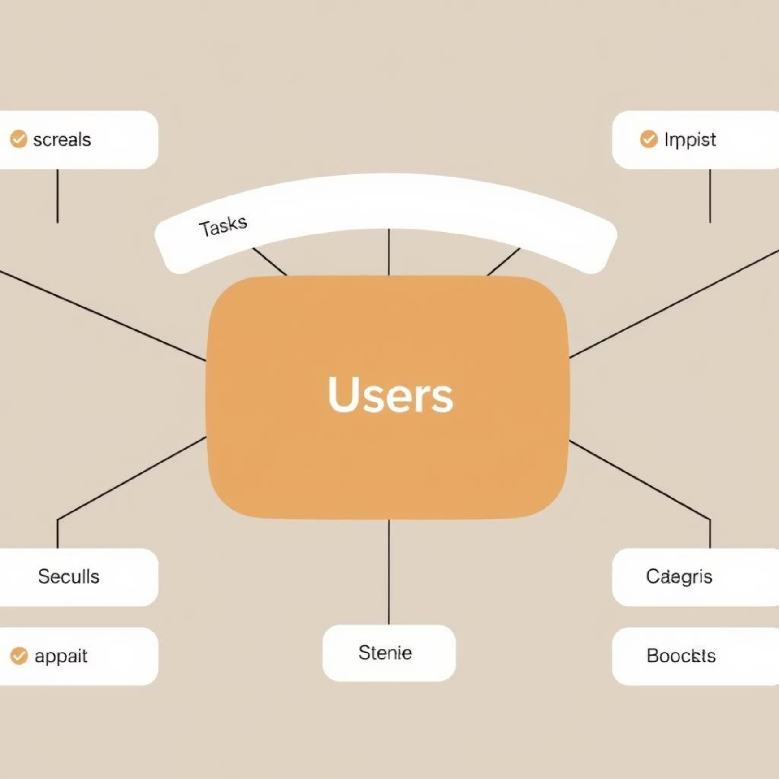
Foundational Design: Database Schema
A well-structured database is the backbone of any reliable application. We've designed a clear, interconnected schema for efficient data storage and retrieval. Let’s
delve into each table.
Users Table: The central entity, storing user authentication details.
Categories Table: Flexible categorisation for both tasks and expenses.
Tasks Table: Manages individual to-do items with descriptions and due dates.
Expenses Table: Tracks all financial outflows, linking to tasks or categories.
Budgets Table: Enables monthly financial planning and tracking.

Slide 5
Detailed Schema Breakdown
Here's a closer look at the structure of each table, including primary and foreign keys, data types, and constraints.
Table Name
Key Columns
Other Key Columns
Constraints
Purpose
USERS
user_id (PK)
username, email, password
email UNIQUE, username NOT NULL
User authentication & profile
CATAGORIES
category_id (PK)
category_name, category_type
category_type IN ('task', 'expense')
Categorises tasks and expenses
TASKS
task_id (PK)
user_id (FK), title, description, category_id (FK), status
status IN ('pending', 'completed'), user_id REF USERS
Manages user's to-do items
EXPENSES
expense_id (PK)
user_id (FK), category_id (FK), task_id (FK), amount, expense_date
user_id REF USERS, category_id REF CATEGORIES
Tracks financial expenditures
BUDGETS
budget_id (PK)
user_id (FK), month, amount
user_id REF USERS
Sets monthly spending limits
Each table is designed to be highly normalised, ensuring data integrity and minimising redundancy.

Slide 6

Populating the Database
To test our schema and demonstrate functionality, we've populated the database with sample data across all tables. This allows us to immediately begin querying and interacting with the system.
Sample Tasks
Complete project, Buy groceries, Team meeting
Sample Users
Alice, Bob, Charlie, Diana, Eve
Gym workout, Call client
Sample Categories
Sample Expenses
Work, Personal (tasks)
Lunch at cafe, Taxi fare, Concert tickets
Food, Transport, Shopping (expenses)
Snacks, Bus pass
Sample Budgets
Monthly budgets for all users for 'August 2025'

Slide 7
Efficiency Through Procedures: Streamlining Operations
Stored procedures and functions are crucial for encapsulating business logic and improving performance. They provide a secure and efficient way to interact with our database.
Add Task (add_task)
Add Expense (add_expense)
Quickly insert new tasks for a user, specifying title, description, category, and due date.
Records new expenses with details like amount, description, category, and associated task (optional).
Set Task Status (set_task_status)
Set Budget (set_budget)
Updates the completion status of a task from 'pending' to 'completed' or vice-versa.
Sets or updates a user's monthly budget, handling both new entries and modifications.

Slide 8

Calculating Remaining Budget
The get_remaining_budget function is a powerful tool for users to monitor their spending against their allocated budget for a given month.
Function: get_remaining_budget(p_user_id, p_month)
Purpose: Calculates the difference between a user's total budget for a specific month and their total expenses incurred during that month.
How it works:
Retrieves the total budget amount for the user and month.
Sums up all expenses for the user where the expense date falls within the specified month.
Returns the budget Aminus the total expenses.
Benefit: Provides immediate financial insight, helping users stay within their spending limits.

Slide 9





The Power of Integration
Our design allows for seamless integration between task management and expense tracking, creating a holistic personal management system.
Linked Data
Expenses can be directly linked to specific tasks, providing granular cost tracking for projects or activities.
Budget Oversight
Users can monitor spending against their budgets, with categorisation aiding in identifying spending patterns.
Streamlined Workflow
Stored procedures simplify complex operations, making the system user- and developer-friendly.
Future Scalability
The modular schema design supports future enhancements, such as reporting or notification features.

Slide 10
Key Takeaways & Next Steps
Key Takeaways
Future Enhancements
Robust Schema: A well-defined SQL schema underpins a powerful application.
Web Interface: Develop a user-friendly frontend for easy interaction.
Data Integrity: Constraints and relationships ensure data accuracy.
Advanced Reporting: Generate detailed reports on spending habits and task completion.
Procedural Efficiency: Stored procedures and functions automate common tasks, improving efficiency.
Recurring Entries: Implement functionality for recurring tasks and expenses.
Notifications: Add alerts for upcoming deadlines or budget thresholds.
Holistic View: Integration of tasks and expenses provides a comprehensive personal management tool.

Slide 11
Advantages of a Combined To-Do List & Expense Tracker
Holistic Life Management:
-Benefit: It provides a unified platform to manage both your time (tasks) and money (expenses). This gives you a complete picture of your productivity and financial health in one place, showing how your actions directly impact your budget.
Contextual Spending:
-Benefit: You can link expenses directly to tasks. For example, after checking off the task "Grocery Shopping," you can immediately log a $150 expense categorized as "Food." This adds context to your spending, making it easier to remember what a purchase was for.
Project-Based Budgeting:
-Benefit: It's excellent for managing projects with budgets. You can create a task list for "Home Renovation" and track all related expenses (paint, tools, contractors) against a set budget right within the same project, ensuring you don't overspend.
Convenience and Efficiency:
-Benefit: It reduces app-switching. Users don't need to jump between a separate to-do app and a finance app, streamlining their workflow and saving time.

Slide 12
Disadvantages of a Combined To-Do List & Expense Tracker
Increased Complexity:
-Drawback: From a development perspective, you are building and maintaining two complex systems (task management and financial tracking) within one application. This leads to a more complicated codebase, potential for more bugs, and a longer development time.
Security and Privacy Concerns:
-Drawback: You are combining sensitive financial data with personal task information. This makes the application a much more attractive target for hackers and significantly increases the stakes of a data breach. It requires robust security measures (like strong encryption), which add to development complexity and cost.
Market Competition:
-Drawback: It's challenging to compete with established, best-in-class standalone applications. Users often prefer using a dedicated, powerful to-do app (like Todoist or Microsoft To Do) alongside a dedicated, powerful finance app (like Mint or Expensify) rather than a combined tool that may do both things in a mediocre way.
Risk of Feature Bloat:
-Drawback: The app can easily become a "jack of all trades, master of none." Instead of excelling at one thing, it risks being average at both task management and expense tracking, failing to meet the high standards users have for either function.

Slide 13
Conclusion:
The Balanced View
This project is a classic example of a high-potential, high-risk idea.
As a user product, its success hinges on seamless integration and a clean, intuitive design that doesn't sacrifice simplicity for the sake of features.
As a development project, it's an excellent challenge that touches upon multiple key areas: UI/UX design, database management, state management, and security, making it a fantastic portfolio piece.
The key is to execute it in a way where the whole becomes greater than the sum of its parts, rather than just two separate apps awkwardly bolted together.

Slide 14
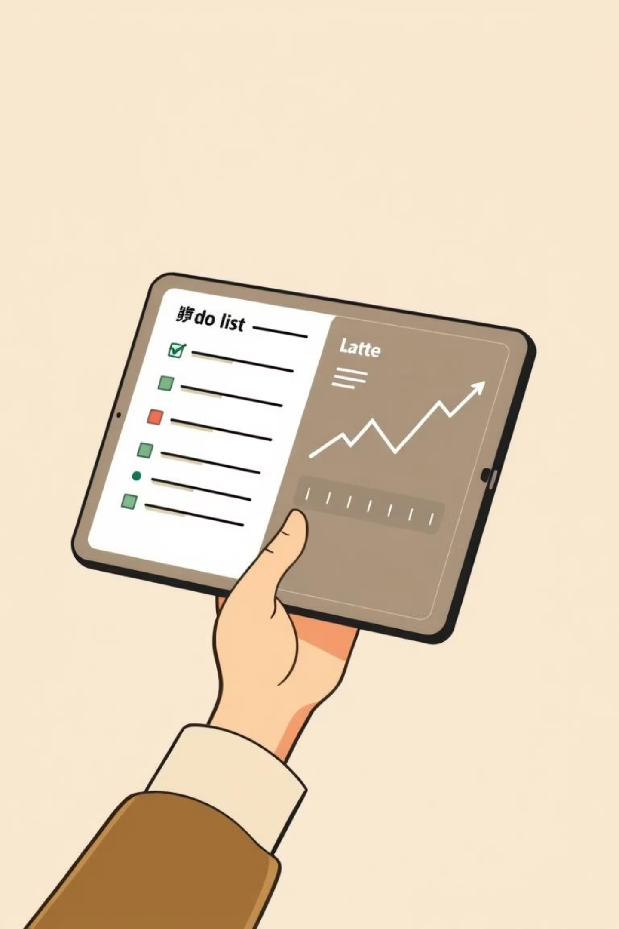
Thank You!
We hope this deep dive into our To-Do List and Expense Tracker SQL schema has been insightful.

